Slide 1
Data science R-DAT 5302 FMSBA
Instructor-Nabanita Talukdar, DBA
Class 3

Slide 2
Learning objectives
Missing values and date values
Data visualization with R with ggplot2
Graph, scatter plot, box plot, bar plot
Working through examples
Summary
Discuss Assigned Readings
In-class assignment

Slide 3
Missing Values and Date Values
In R, missing values are represented by the symbol NA (not available)
Unlike programs such as SAS, R uses the same missing value symbols for character and numeric data
The function is.na () allows you to test for the presence of missing values
Dates are typically stored into R as character strings and then translated into date variables that are stored numerically
The function as.Date() is used to make this translation. The syntax is as.Date(x, “input_format”), where x is the character data and input_format gives the appropriate format for reading the date

Slide 4
The art of presenting data
Graphs should show the data
Induce the reader to think about the data being presented (rather than some other aspect of the graph)
Avoid distorting the data
Present many numbers with minimum ink
Make large datasets (assuming you have one) coherent
Encourage the reader to compare different pieces of data
Reveal data
(Reference- Tufte, (2001), From Andy Field’s Discovering Statistics with R)

Slide 5
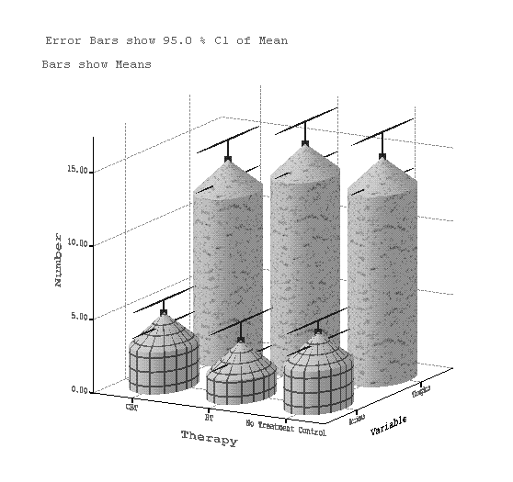
Why Is This Graph Bad?
Reference, Discovering Statistics Using R, Andy Field

Slide 6
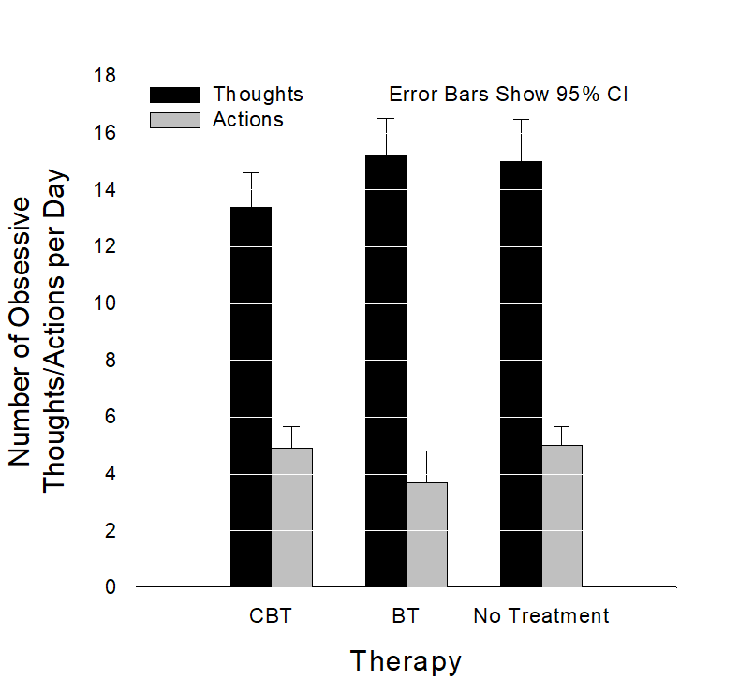
Why is this Graph Better?
A 2-D plot
The y-axis has a more informative label-We now know that it was the number of obsessive thoughts or actions per day that was being measured
Distractions-There are fewer distractions such as patterns and cylindrical bars
Reference, Discovering Statistics Using R, Andy Field

Slide 7
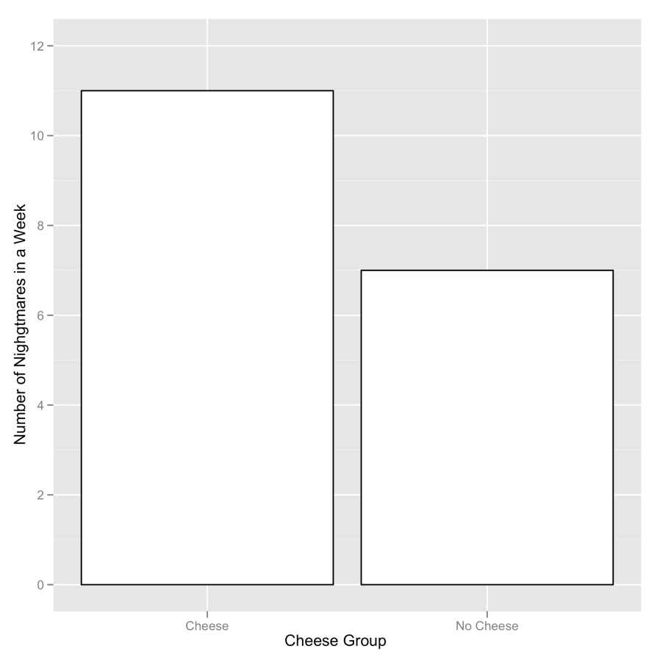
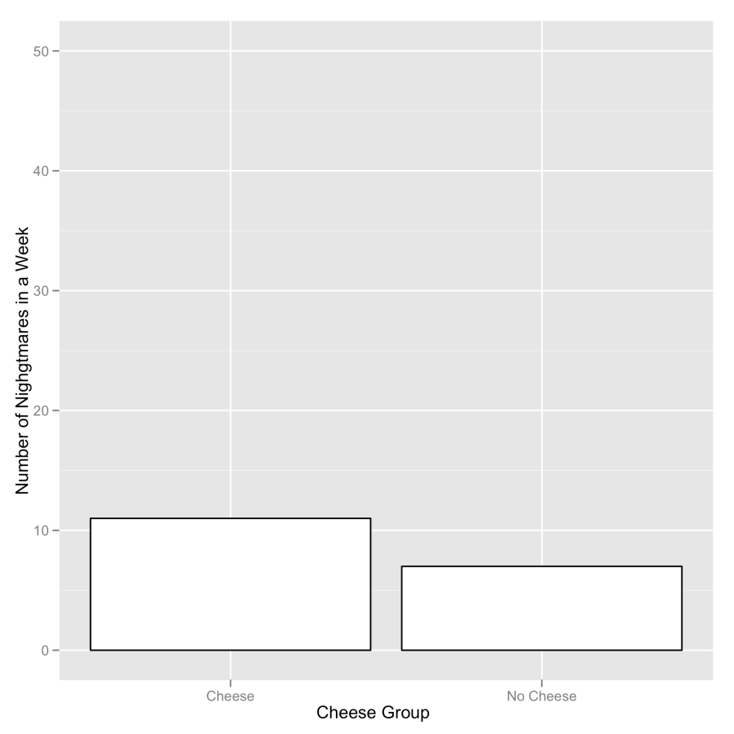
Deceiving the Reader
Two graphs about cheese
Reference, Discovering Statistics Using R, Andy Field

Slide 8
ggplot2
R has accumulated three different plotting systems-base graphics, lattice, ggplot2
ggplot2 is the most versatile tool and you can do everything you want in ggplot2
The finished plot is made of layers, each layer contains some geometric elements (such as bars, points, lines, text known as geom
The appearance and location of these geoms (e.g., size, color, shape used) is controlled by aesthetic properties aes()

Slide 9
ggplot2
In ggplot2 a plot is made up of layers.
Reference, Discovering Statistics Using R, Andy Field

Slide 10
The anatomy of a graph
Reference, Discovering Statistics Using R, Andy Field
The anatomy of a graph

Slide 11
Geometric objects (geoms)
Geometric Objects (geoms)
geom_bar () | creates a layer with bars representing different statistical properties
geom_point () | creates a layer showing the data points ( as you would see on a scatter plot)
geom_line () | creates a layer that connects data points with a straight line
geom_smooth() | creates a layer that contains a smoother (i.e. a line that summarizes the data as a whole rather than connecting individual data points)
geom_histogram() | creates a layer with a histogram on it
geom_boxplot () | creates a layer with a box-whisker diagram
geom_text () | creates a layer with text on it
geom_density() | creates a layer with density plot on it
geom_errorbar() | creates a layer with error bars displayed on it
geom_hline and geom_vline() | creates a layer with user-defined horizontal or vertical line
 | For full list on ggplo2 see http://had.co.nz/ggplot2/
Reference, Discovering Statistics Using R, Andy Field

Slide 12
Aesthetic properties associated with some commonly used geoms
Aesthetic properties associated with some commonly used geoms
Required | Required | Optional
geom_bar () | x: the variable to plot on the x axis | color
 |  | size
 |  | fill
 |  | linetype
 |  | weight
 |  | alpha
geom_point () | x: the variable to plot on the x axis | shape
 | y: the variable to plot on the y axis | color
 |  | size fill
 |  | alpha
geom_line() | x: the variable to plot on the x axis | color
 | y: the variable to plot on the y axis | size
 |  | linetype
 |  | alpha
Reference, Discovering Statistics Using R, Andy Field

Slide 13
Aesthetic properties associated with some commonly used geoms
Aesthetic properties associated with some commonly used geoms
Required | Required | Optional
geom_smooth() | x: the variable to plot on the x axis | color
 | y: the variable to plot on the y axis | size
 |  | fill
 |  | linetype
 |  | weight
 |  | alpha
geom_histogram() | x: the variable to plot on the x axis | color
 |  | size
 |  | fill
 |  | weight
 |  | alpha
 |  | linetype
geom_boxplot() | x: the variable to plot | color
 | ymin: lower limit of 'whisker' | size
 | ymax: upper limit of 'whisker' | fill
 | lower: lower limit of the 'box' | weight
 | upper: upper limit of the 'box' | alpha
 | middle: the median
Reference, Discovering Statistics Using R, Andy Field

Slide 14

Aesthetic properties associated with commonly used geoms
Aesthetic properties associated with some commonly used geoms
Required | Required | Optional
geom_text() | x: the horizontal coordinate of where the text should be placed | color
 | y: the vertical coordinate of where the text should be placed | size
 | label: the text to be printed | angle
 |  | hjust (horizontal adjustment)
 |  | vjust (vertical adjustment)
 |  | alpha
geom_density () | x: the variable to plot on x axis | color
 | y: the variable to plot on y axis | size
 |  | fill
 |  | linetype
 |  | weight
 |  | alpha
geom_errorbar() | x: the variable to plot | color
 | ymin, ymax: lower and upper value of error bar | size
 |  | linetype
 |  | width
 |  | alpha
geom_hline() | yintercept = value | color
geom_vline() | x intercept = value | size
 | (where value is the position on the x- or y-axis where you want the vertical/horizontal line) | linetype
 |  | alpha
Reference, Discovering Statistics Using R, Andy Field

Slide 15
The anatomy of the ggplot () function
mygraph <- ggplot(myData, aes(variable for x axis, variable for y axis, color=gender))
mygraph +geom_point(colour = “Blue”)
ggsave(filename) #function for saving graphs, example ggsave(“Outlier Amazon.png”)
Plot the relationship between NPQC_R_Total (Narcissism) and Rating (profile ratings generally). As such we want NPQC_R_Total plotted on the x- axis and Rating on the y-axis. So the command syntax will be,
graph<- ggplot(mydata, aes(variable for x axis, variable for y axis))
So, the command will be, graph<-ggplot(facebookData, aes(NPQC_R_Total, Rating))-this command will create the object, but there is nothing to print. In order to see something we need to take our object (graph) and add some visual elements. In order to add points, we use graph + geom_point ()

Slide 16
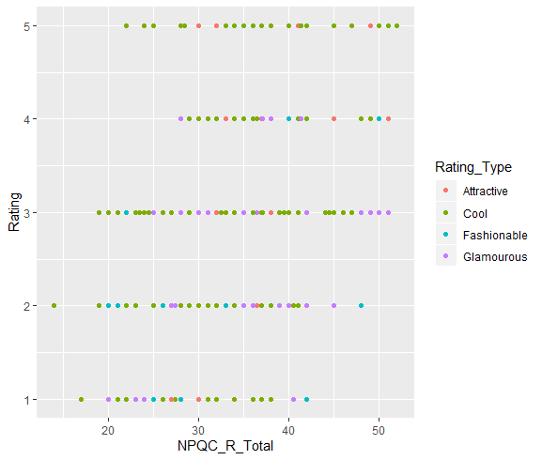
Graphing the relationship between narcissism and the profile rating

Slide 17
Scatterplot
A psychologist was interested in the effects of exam stress on exam performance. The two variables are Anxiety (the score on Exam Anxiety Questionnaire (EAQ)) and Exam (mark on the exam as a percentage)
Plot the relationship between exam anxiety (Anxiety) and exam performance (Exam). We want Anxiety plotted on the x-axis and Exam on the y-axis. We will add those to aes() and the final command will be scatter<-ggplot(examData, aes(Anxiety, Exam))
To add visual elements (i.e. add dots), it will be scatter + geom_point()

Slide 18
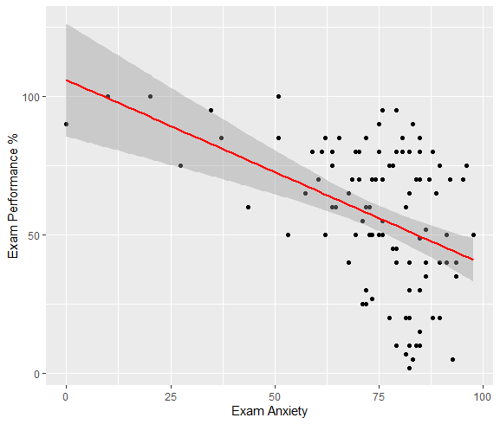
Scatter Plot

Slide 19
Boxplots (box-whisker diagrams)
Boxplots or box-whisker diagrams are useful to display your data
At the center of the plot is the median, which is surrounded by a box the top and bottom of which are the limits within which the middle 50% of observations fall (the interquartile range). Sticking out of the top and bottom of the box are two whiskers that extend to one and half times the interquartile range
Boxplot of hygiene scores on day 1 of Download Festival split by gender

Slide 20
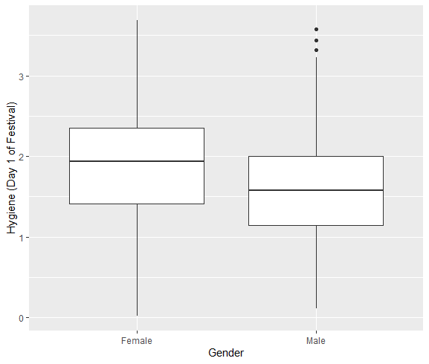
Boxplot
Reference, Discovering Statistics Using R, Andy Field

Slide 21
Bar charts and error bars
Bar charts are a common way to display means.
The error bar sticks out of a bar like a whisker.
The error bar displays the precision of the mean in one of the three ways: the confidence interval (usually 95%), the standard deviation, the standard error of mean

Slide 22
Bar charts for one independent variable
Is there such a thing as a ‘chick flick’?
Participants:
20 men
20 women
Half of each sample saw one of two films:
A ‘chick flick’ (Bridget Jones’s Diary),
Control (Memento).
Outcome measure
Physiological arousal as an indicator of how much they enjoyed the film.
Reference, Discovering Statistics Using R, Andy Field

Slide 23
Bar chart for one independent variable
To plot the mean arousal score (y-axis) for each film (x-axis) first create the plot object:
bar <- ggplot(chickFlick, aes(film, arousal))
To add the mean, displayed as bars, we can add this as a layer to bar using the stat_summary() function:
bar + stat_summary(fun.y = mean, geom = "bar", fill = "White", colour = "Black"
To add error bars, add these as a layer using stat_summary():
+ stat_summary(fun.data = mean_cl_normal, geom = "pointrange")
Finally, let’s add some nice labels to the graph using lab():
+ labs(x = "Film", y = "Mean Arousal")

Slide 24
Bar chart for one independent variable
If we put all of these commands together we can create the graph by executing the following command:
bar + stat_summary(fun.y = mean, geom = "bar", fill = "White", colour = "Black") + stat_summary(fun.data = mean_cl_normal, geom = "pointrange") + labs(x = "Film", y = "Mean Arousal")

Slide 25
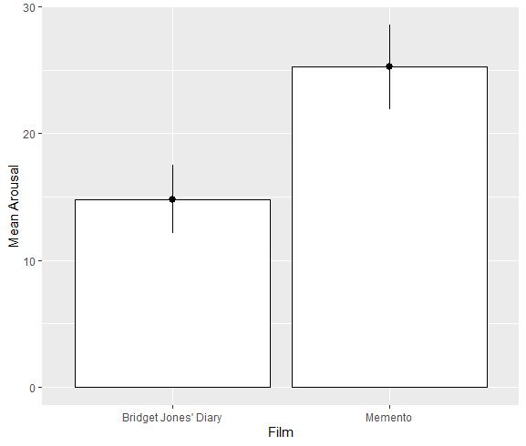
Bar charts for one independent variable
On average, people
enjoyed Memento more than they enjoyed
Bridget Jones’s Diary,
Next, we look at the gender effect

Slide 26
Bar chart for two independent variables
bar <- ggplot(chickflick, aes(film, arousal, fill = gender))
bar + stat_summary(fun.y = mean, geom = "bar", position="dodge") + stat_summary(fun.data = mean_cl_normal, geom = "errorbar", position = position_dodge(width = 0.90), width = 0.2) + labs(x = "Film", y = "Mean Arousal", fill = "Gender")

Slide 27
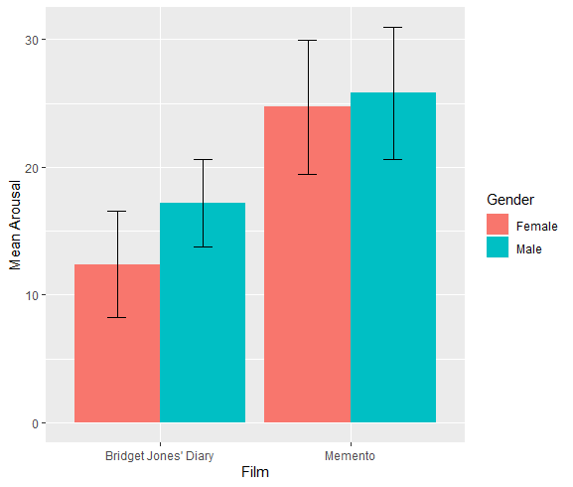
Bar chart for two independent variables
Male enjoyed Bridget Jones Diary more
than female

Slide 28
Using stat_summary () to create graphs
Using stat_summary () to create graphs
Option | Plots | Common geom
fun.y=mean | The mean | geom="bar"
fun.y=median | The median | geom="bar"
fun.data=mean_cl_normal() | 95% confidence intervals assuming normality | geom="errorbar" geom="pointrange"
fun.data=mean_cl_boot() | 95% confidence intervals based on a bootstrap (i.e., not assuming normality) | geom="errorbar" geom="pointrange"
mean_sd() | Sample mean and standard deviation | geom="errorbar" geom="pointrange"
fun.data=median_hilow() | Median and upper and lower quantiles | geom="pointrange"
Reference, Discovering Statistics Using R, Andy Field

Slide 29
In-class assignment 2
Use the dataset women plot a scatter plot between height and weight of women (#refer example 1 from class_3_R_script)
Use the dataset mtcars and plot Boxplot of mpg split by number of cylinders (cyl.f) #refer example 2 from class_3_R_script
Bar chart for one independent variable. #Use the dataset SpiderLong.dat shared in module 3 and plot a bar of Anxiety (y-axis) for each Group (x-axis). #refer example 3 from class_3_R_script
For submission follow the submission template available under class_2

Slide 30
Summary
is.na() and as.Date()
The art of creating graphs
ggplot2 (geoms() and aes())
Graphs with ggplot2
Scatter plot, Box plot, and bar plots

